Slide 1




MIU Computer science Gpa calculator
Presenters:
Abdelrahman Refaey 2023/05260
Abdulkader Adnan 2023/07019
Ali Mohamed 2023/06123
Omar Ehab 2023/06195

Slide 2

Introduction
MIU GPA Calculater has two features:
1.Admin Feature:
  Enter scores.
2.Student Feature:
  view transcript.
  calculate gpa.

Slide 3

Agenda
  Architecture
  Description of each function
  Menu Functions
  Instructions for running the program
  Input Files
  Sample Input/output

Slide 4

Course Class
Attributes:
  string courseName: coures’ name.
  int creditHours: credit hours number of the course.
  double score: student score obtained in specefic course.
  double gradePoint: grade point of score.
  string letterGrade: letter grade of to the score.

Slide 5
Course Class
Functions:
  Course(string name = "", int credits = 0)
    initialize a course with a name and credit hours.
  void computeGradePoint()
    calculate the grade point and letter grade according to the score.

Slide 6
Semester Class
Attributes:
  Course courses[MAX_COURSES]: array to store courses in the semester.
  int courseCount: number of courses in the semester.

Slide 7
Semester Class
Functions:
  Semester()
initialize a semester with zero courses.
  void addCourse(const Course& course)
Add a course to the semester .

Slide 8
Student Class
Arrtiributes:
  string id: Student's ID.
  Semester semesters[MAX_SEMESTERS]: An array to store semesters.
  int semesterCount: The number of semesters.

Slide 9
Student Class
Functions:
  Student(string studentId = "")
    initialize a student with an ID and zero semesters.
  void addCourse(int semester, const Course& course)
    Adds a course to the specified semester.
  void enterScore(int semester, string courseName, double score)
    Enters the score for a specified course in the specified semester and computes the grade point.

Slide 10
Student Class
Functions:
  double computeGPA(int semester)
Computes the GPA for the specified semester.
  double computeCumulativeGPA()
Computes the cumulative GPA across all semesters.
  void printTranscript()
Prints the transcript for the student, including details of each course, GPA for each semester, and cumulative GPA.

Slide 11
Student Class
Functions:
  void loadCoursesFromFile(const string& filePath)
Loads course information from a specified file.
  void loadScoresFromFile(const string& filePath)
Loads student scores from a specified file.
  void saveScoresToFile(const string& filePath)
Saves the current scores to a specified file.
  double computeGPAForEnteredScores(int totalCreditHours, double totalQualityPoints)
Computes GPA based on the entered scores and credit hours.

Slide 12
Menu Functions
Functions:
  void adminMenu(Student& student)
    Provides the admin menu for entering scores for a student.
  void studentMenu(Student& student)
    Provides the student menu for viewing transcripts and computing GPA for entered scores.
  void mainMenu(Student& student)
    Provides the main menu for selecting between admin and student roles and performing respective operations.

Slide 13


Instructions for Compiling and Running the Program
  To compile the program, use a C++ compiler
  Ensure that all the source code is in a file named main.cpp.

Slide 14
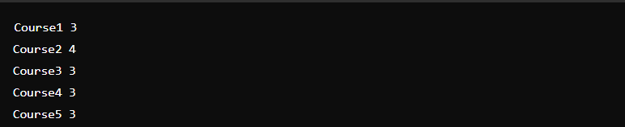
Input files
  courses.txt: This file should contain the list of courses and their credit hours
Example format:

Slide 15
Program Execution
  Enter the student ID .
  Select the user type (Admin or Student).
  As an Admin, enter scores for courses in a specified semester.
  As a Student, view the transcript and calculate GPA for entered scores if desired.
  The program reads and writes to the courses.txt and students.txt files for loading and saving data.

Slide 16
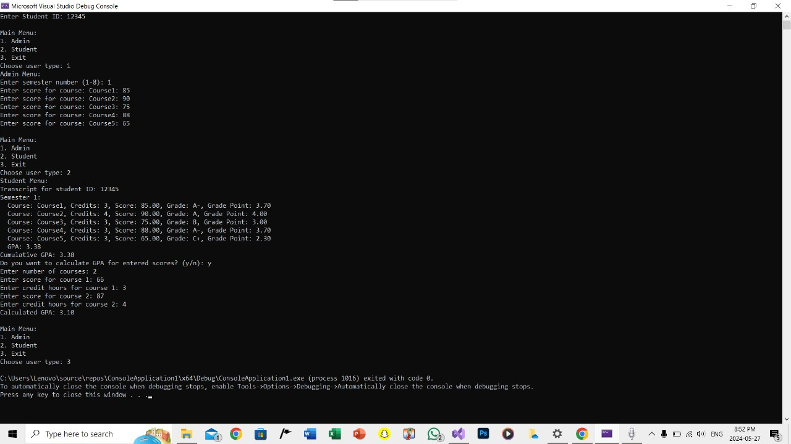
Sample output

Slide 17
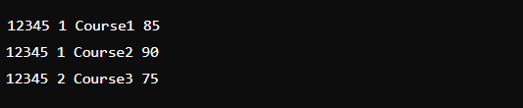
Sample file output (students.txt)

Slide 18

Thank You

